Slide 1
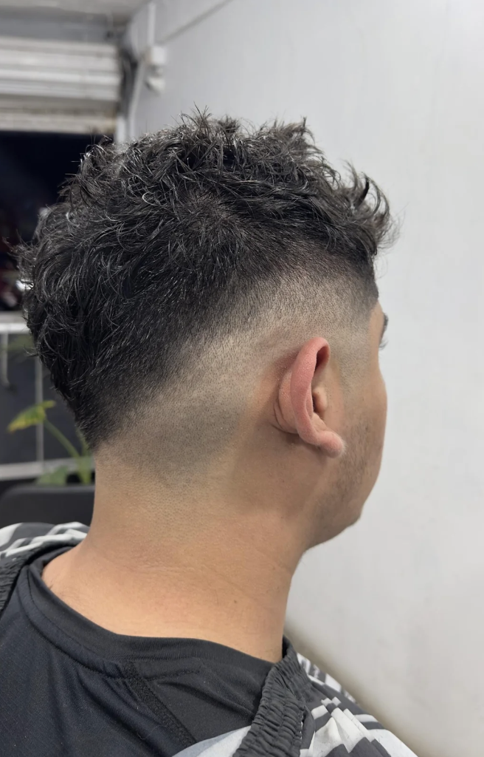
SHARP LINE CUTS
Cuts Before Christmas
Community Day at the Livernois Shop
Saturday, December 19, 2026 · 9:00 AM to 2:00 PM
18247 Livernois Ave, Detroit, MI 48221 · All hands

Slide 2
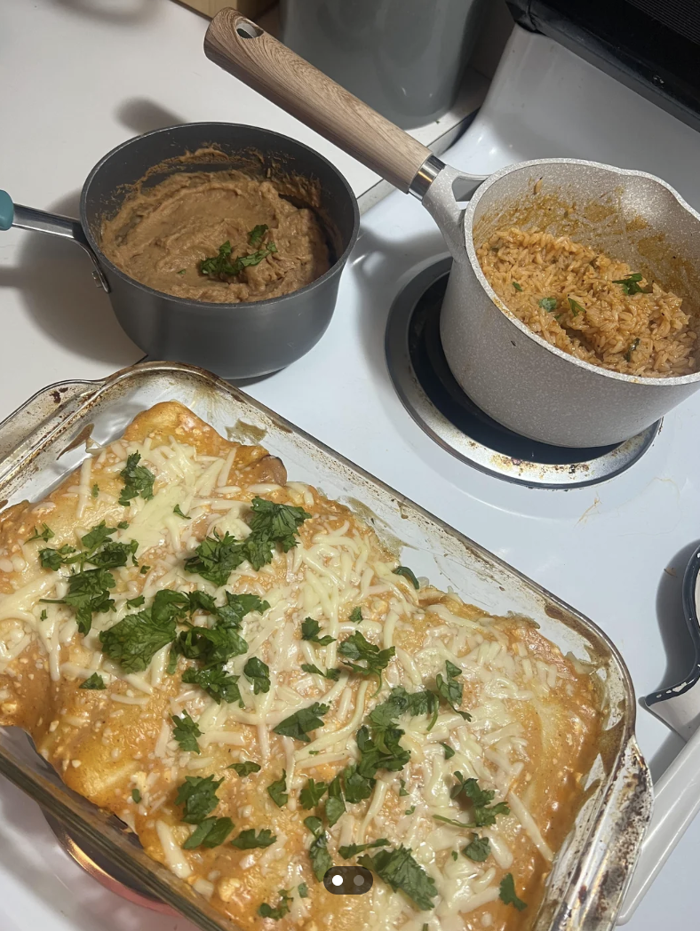
What We're Doing
The Plan
● Free kids cuts
All kids 12 and under get a free cut from whoever is in the chair. No appointment, walk-in only.
● Food from El Sol Kitchen
Tacos, horchata, and churros from Fenkell. James pre-ordered; confirmed for 11:00 AM delivery.
● Pinnacle giveaways
Pinnacle pomade and beard oil samples plus Ty's handmade combs for adults.
● DJ set
Music from 9:00 AM through close. Good energy for a Saturday morning.
● Photo moment
Group photo with the staff and community at noon. Community board gets a copy.

Slide 3
Run of Show
Saturday, December 19, 2026
8:00 AM
Setup
James and Ty arrive. Balloons and banners. Sound check with DJ.
9:00 AM
Doors Open
Walk-in queue starts. Darius manages floor flow. Andre on standby.
9:30 AM
First Cuts
All four chairs active. Ty on kids, James and Darius on adults.
11:00 AM
Food Arrives
El Sol Kitchen delivery. Community tables set up outside.
12:00 PM
Giveaway + Photo
Pinnacle samples and Ty's combs at the front. Group photo.
1:30 PM
Last Cuts Called
Queue closes. Anyone already in line gets taken.
2:00 PM
Close + Reconcile
Clean up. James tallies the count. Debrief with staff.

Slide 4
Event Budget
Total: $2,203.98, all line items verified
Line Summary
Catering (El Sol Kitchen) $879.00
Giveaways (Pinnacle + combs) $633.00
Music (DJ + audio) ...... $350.00
Decorations (signs + balloons) $125.00
Marketing (social + flyers) $120.00
Misc (towels, drinks, sundry) $96.98
TOTAL ................... $2,203.98
Funded from shop event reserve. No client charge-through.

Slide 5
Staff Roles
Everybody has a lane. Everybody stays in it.
J
James
D
Darius
● Catering confirm and setup coordination (Thu/Fri before).
● Opens and closes the shop. Final reconcile at 2 PM.
● Sound check with DJ at 8 AM. Handles any vendor issues.
● Kids cut station 9 AM through 1 PM.
● Social media promo (posts, check-ins through the day).
● Floor flow management: queue order, wait time calls.
● Adult cuts alongside James. Covers any overflow.
A
Andre
T
Ty
● Flyer distribution on Livernois 9-11 AM.
● Kids cut support after 11 AM.
● Photo moment coordination at noon.
● Handmade comb giveaway table management.
● Balloon and decoration setup at 8 AM.
● Apprentice-rate cuts on kids 9 AM to 1:30 PM.

